Slide 1
PulseInsight: Columnar Analytics for Healthcare Data Using DuckDB
Ellie He
DSCI 551 — Spring 2026

Slide 2
Project Introduction
What is PulseInsight?
A lightweight analytical platform for exploring healthcare data
Focuses on patient metrics (Glucose, BMI, Age, Outcome)
Supports:
Aggregation (e.g., averages)
Filtering (e.g., high-risk patients)
Group analysis (e.g., by outcome)
Goal
Understand how database internals affect analytical performance

Slide 3
Core Internal Focus
Focus Area: Columnar Storage (DuckDB)
Data stored column-by-column, not row-by-row
Only required columns are scanned during queries
Why this matters
Analytical queries usually use few columns, many rows
Reduces unnecessary data access
Improves performance for analytical workloads

Slide 4
Database Architecture Overview
DuckDB Design (OLAP-focused)
Columnar storage engine
Vectorized query execution (batch processing)
In-process database (no server needed)
compared to Row-Based Systems (e.g., MySQL):
Row-based | Column-based
Reads full rows | Reads only needed columns
Good for transactions | Good for analytics

Slide 5
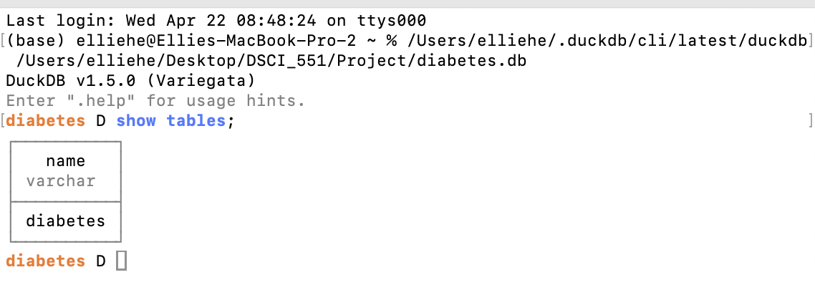
Open DuckDB

Slide 6
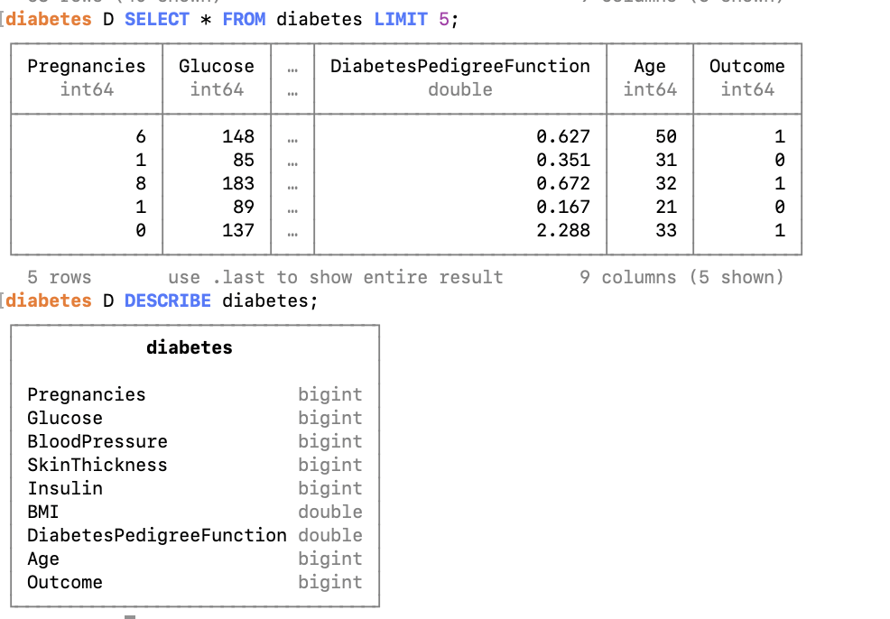
Table preview
SELECT * FROM diabetes LIMIT 5;
DESCRIBE diabetes;

Slide 7
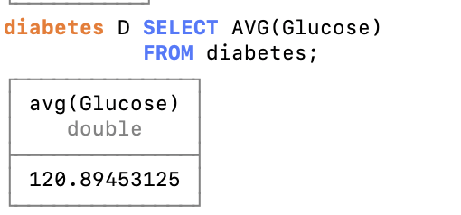
Query 1 - Aggregation
SELECT AVG(Glucose)
FROM diabetes;
Application
Compute average glucose
Database Internals
Scans only the Glucose column
Why it matters
Avoids reading unnecessary columns
Reduces I/O → faster queries

Slide 8
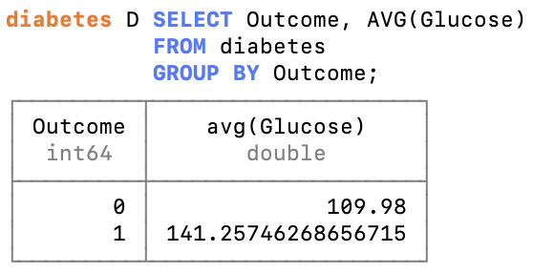
Query 2 - Group Aggregation
SELECT Outcome, AVG(Glucose)
FROM diabetes
GROUP BY Outcome;
Application
Compare groups by Outcome
Database Internals
Scans only Outcome + Glucose
Performs grouping + aggregation
Why it matters
Columnar layout makes grouping efficient

Slide 9
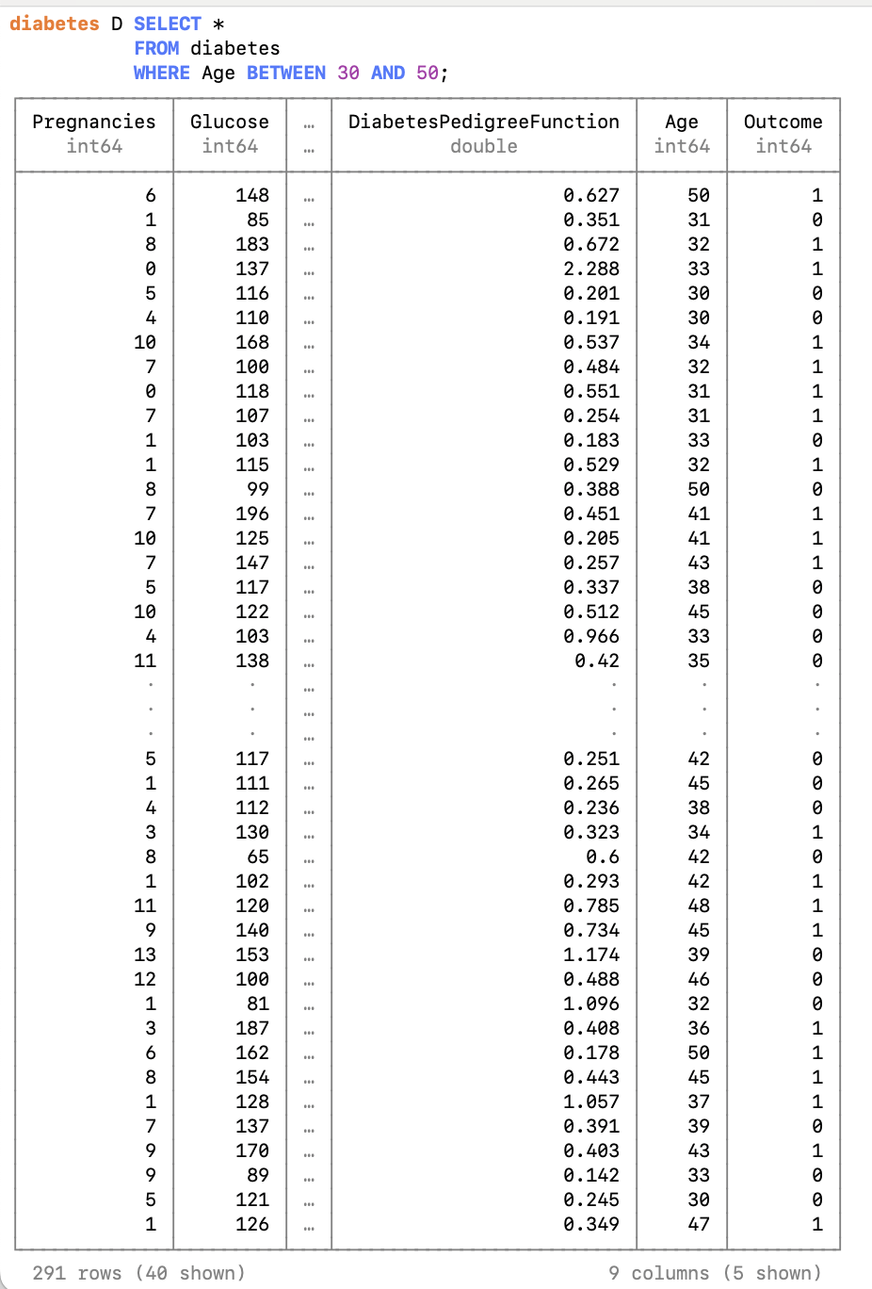
Query 3 - Range Query
SELECT *
FROM diabetes
WHERE Age BETWEEN 30 AND 50;
Application
Retrieves patients within the age range of 30 to 50
Used for cohort analysis (e.g., studying middle-aged population)
Database Internals
DuckDB scans the Age column to evaluate the range condition
Applies a predicate filter to identify matching rows
Then retrieves corresponding rows from other columns
Why It Matters
Columnar storage allows scanning only the Age column first
Reduces unnecessary data access compared to scanning full rows
Efficient for range queries due to sequential column access

Slide 10
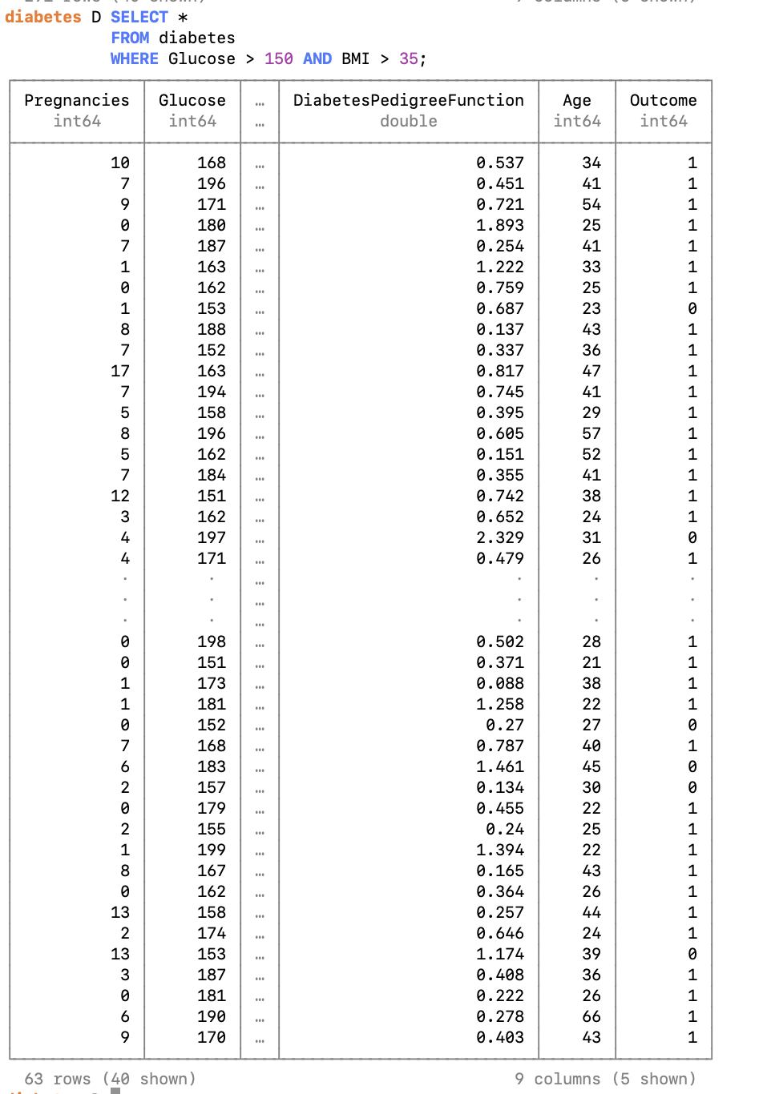
Query 4 - Value Filtering
SELECT *
FROM diabetes
WHERE Glucose > 150 AND BMI > 35;
Application
Find high BMI patients
Database Internals
Scans BMI column and applies predicate
Why it matters
Efficient filtering on a single attribute

Slide 11
Key Takeaways
Database internals directly impact application performance
Columnar storage is ideal for analytical workloads
DuckDB efficiently supports:
Aggregations
Filtering
Grouped analysis
Matching workload patterns with database design leads to better performance

